Slide 1

Management Information Systems: Managing the Digital Firm
Fifteenth edition
Chapter 6
Foundations of Business
Intelligence: Databases and
Information Management

Slide 2
Problems with the Traditional File Environment
Files maintained separately by different departments
Data redundancy
Data inconsistency
Program-data dependence
Lack of flexibility
Poor security
Lack of data sharing and availability

Slide 3
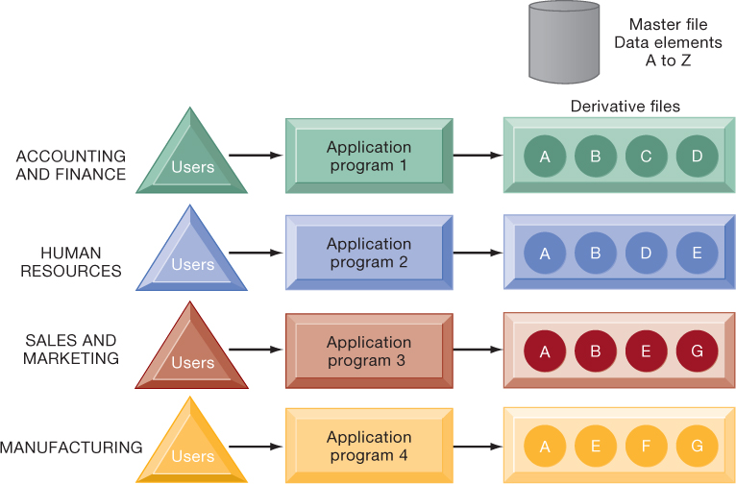
Figure 6.2: Traditional File Processing

Slide 4
Database Management Systems
Database
  Serves many applications by centralizing data and controlling redundant data
Database management system (DBMS)
  Interfaces between applications and physical data files
  Separates logical and physical views of data
  Solves problems of traditional file environment
    Controls redundancy
    Eliminates inconsistency
    Uncouples programs and data
    Enables organization to centrally manage data and data security

Slide 5
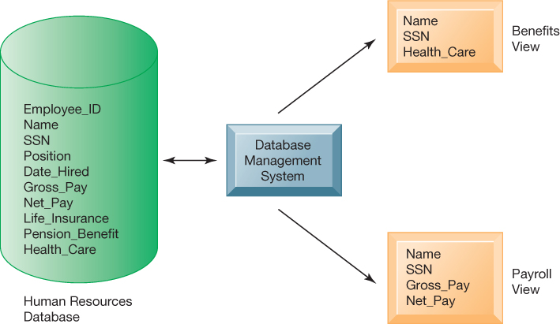
Figure 6.3: Human Resources Database with Multiple Views

Slide 6
Relational DBMS
Represent data as two-dimensional tables
Each table contains data on entity and attributes
Table: grid of columns and rows
  Rows (tuples): Records for different entities
  Fields (columns): Represents attribute for entity
  Key field: Field used to uniquely identify each record
  Primary key: Field in table used for key fields
  Foreign key: Primary key used in second table as look-up field to identify records from original table

Slide 7
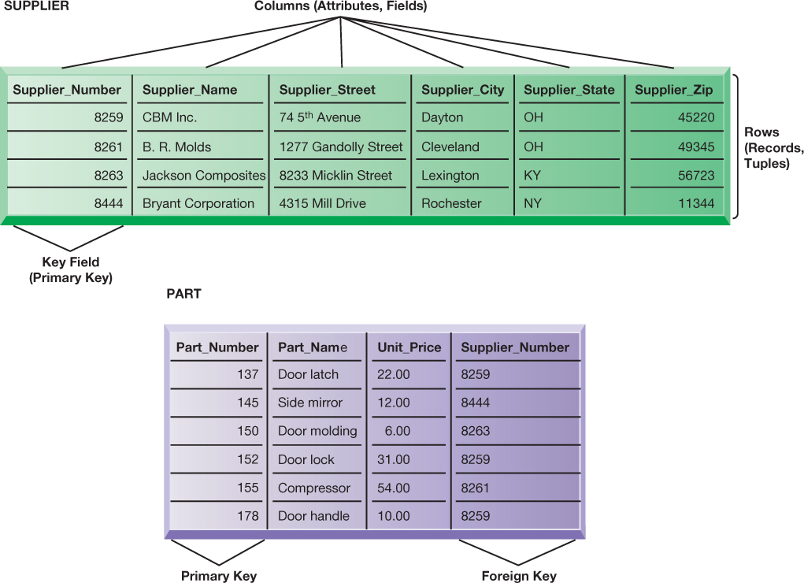
Figure 6.4: Relational Database Tables

Slide 8
Operations of a Relational DBMS
Three basic operations used to develop useful sets of data
  SELECT
    Creates subset of data of all records that meet stated criteria
  JOIN
    Combines relational tables to provide user with more information than available in individual tables
  PROJECT
    Creates subset of columns in table, creating tables with only the information specified

Slide 9
Capabilities of Database Management Systems
Data definition capability
Data dictionary
Querying and reporting
  Data manipulation language
    Structured Query Language (SQL)
Many DBMS have report generation capabilities for creating polished reports (Microsoft Access)

Slide 10
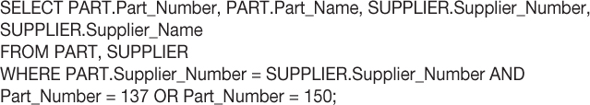
Figure 6.7: Example of an SQL Query

Slide 11
Designing Databases
Conceptual design vs. physical design
Normalization
  Streamlining complex groupings of data to minimize redundant data elements and awkward many-to-many relationships
Referential integrity
  Rules used by RDBMS to ensure relationships between tables remain consistent
Entity-relationship diagram
A correct data model is essential for a system serving the business well

Slide 12
Non-relational Databases and Databases in the Cloud
Non-relational databases: “NoSQL”
  More flexible data model
  Data sets stored across distributed machines
  Easier to scale
  Handle large volumes of unstructured and structured data
Databases in the cloud
  Appeal to start-ups, smaller businesses
  Amazon Relational Database Service, Microsoft SQL Azure
  Private clouds

Slide 13
The Challenge of Big Data
Big data
  Massive sets of unstructured/semi-structured data from web traffic, social media, sensors, and so on
Volumes too great for typical DBMS
  Petabytes, exabytes of data
Can reveal more patterns, relationships and anomalies
Requires new tools and technologies to manage and analyze

Slide 14
Business Intelligence Infrastructure (1 of 3)
Array of tools for obtaining information from separate systems and from big data
Data warehouse
  Stores current and historical data from many core operational transaction systems
  Consolidates and standardizes information for use across enterprise, but data cannot be altered
  Provides analysis and reporting tools

Slide 15
Business Intelligence Infrastructure (2 of 3)
Data marts
  Subset of data warehouse
  Typically focus on single subject or line of business
Hadoop
  Enables distributed parallel processing of big data across inexpensive computers
  Key services
    Hadoop Distributed File System (HDFS): data storage
    MapReduce: breaks data into clusters for work
    Hbase: NoSQL database
  Used Yahoo, NextBio

Slide 16
Business Intelligence Infrastructure (3 of 3)
In-memory computing
  Used in big data analysis
  Uses computers main memory (RAM) for data storage to avoid delays in retrieving data from disk storage
  Can reduce hours/days of processing to seconds
  Requires optimized hardware
Analytic platforms
  High-speed platforms using both relational and non-relational tools optimized for large datasets

Slide 17
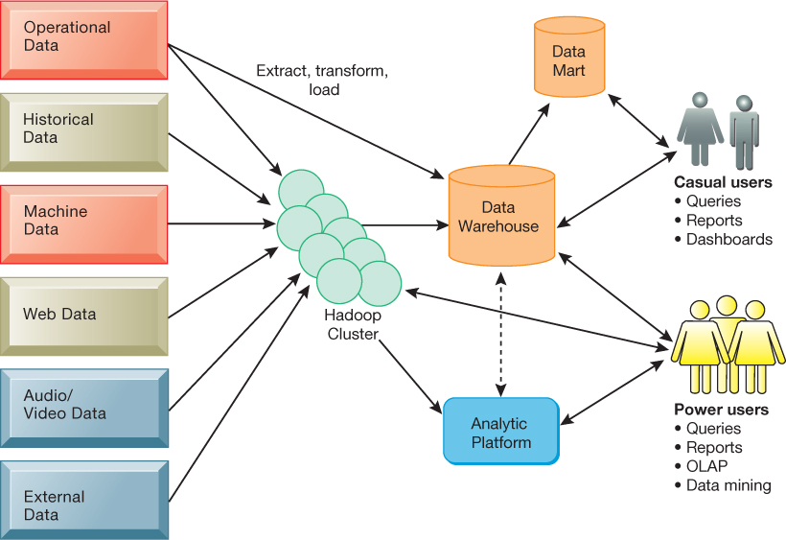
Figure 6.12: Contemporary Business Intelligence Infrastructure

Slide 18
Analytical Tools: Relationships, Patterns, Trends
Tools for consolidating, analyzing, and providing access to vast amounts of data to help users make better business decisions
  Multidimensional data analysis (OLAP)
  Data mining
  Text mining
  Web mining

Slide 19
Online Analytical Processing (OLAP)
Supports multidimensional data analysis
  Viewing data using multiple dimensions
  Each aspect of information (product, pricing, cost, region, time period) is different dimension
  Example: How many washers sold in the East in June compared with other regions?
OLAP enables rapid, online answers to ad hoc queries

Slide 20
Data Mining
Finds hidden patterns, relationships in datasets
  Example: customer buying patterns
Infers rules to predict future behavior
Types of information obtainable from data mining:
  Associations
  Sequences
  Classification
  Clustering
  Forecasting
Notes:
Associations: Occurrences linked to single event
Sequences: Events linked over time
Classification: Recognizes patterns that describe group to which item belongs
Clustering: Similar to classification when no groups have been defined; finds groupings within data
Forecasting: Uses series of existing values to forecast what other values will be

Slide 21
Text Mining and Web Mining
Text mining
  Extracts key elements from large unstructured data sets
  Sentiment analysis software
Web mining
  Discovery and analysis of useful patterns and information from web
  Web content mining
  Web structure mining
  Web usage mining

Slide 22
Databases and the Web
Many companies use the web to make some internal databases available to customers or partners
Typical configuration includes:
  Web server
  Application server/middleware/CGI scripts
  Database server (hosting DBMS)
Advantages of using the web for database access:
  Ease of use of browser software
  Web interface requires few or no changes to database
  Inexpensive to add web interface to system

Slide 23
Establishing an Information Policy
Firm’s rules, procedures, roles for sharing, managing, standardizing data
Data administration
  Establishes policies and procedures to manage data
Data governance
  Deals with policies and processes for managing availability, usability, integrity, and security of data, especially regarding government regulations
Database administration
  Creating and maintaining database

Slide 24
Ensuring Data Quality
More than 25 percent of critical data in Fortune 1000 company databases are inaccurate or incomplete
Before new database is in place, a firm must:
  Identify and correct faulty data
  Establish better routines for editing data once database in operation
Data quality audit
Data cleansing

Slide 25
End

